Slide 1
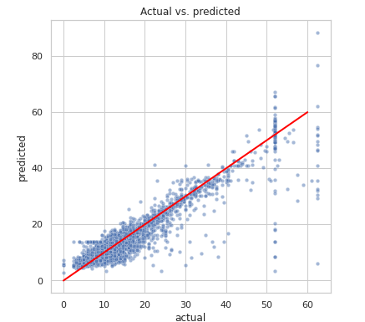
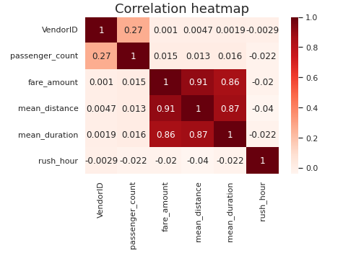
New York City TLC
Executive summary by Automatidata
New York TLC has consulted Automatidata to build a regression model that can predict taxi fares before hand. In the Course 4 component, EDA has been performed, data has been transformed and cleaned and then a regression model is built using python resources.
The regression model had good results overall. Approximately, 82% of its variance was explained which demonstrated the fact that the model was not overfit.
Model metrics were given as follows: -
R^2: 0.824
MAE: 2.5
MSE: 19.65
RMSE: 4.43
The following correlations were found using Pearson’s analysis: -
Ride duration had the significant impact on fare amount with an increase of $9.45 in fare amount for +1 standard deviation of ride duration.
The MLR shown above is a demonstration of successful taxi fare prediction of rides beforehand. The model performance is high on both training and testing sets showing the model is not overfit. It performed better on test data.

